Slide 1




Business Data Management Capstone Project
Analysis of Sales Data of Computech Computers
Shwetha Sajeev
21f1000167

Slide 2
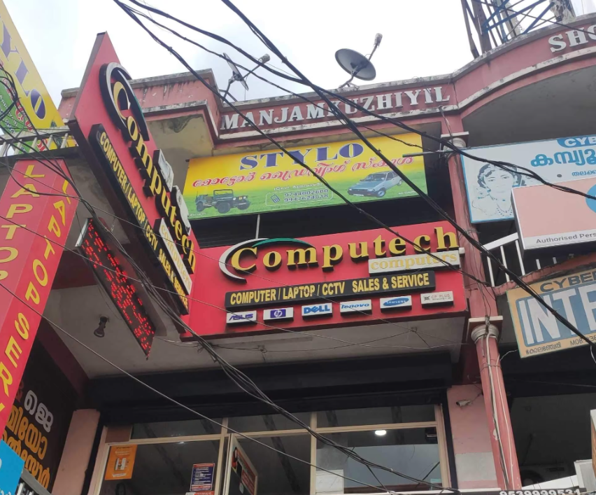
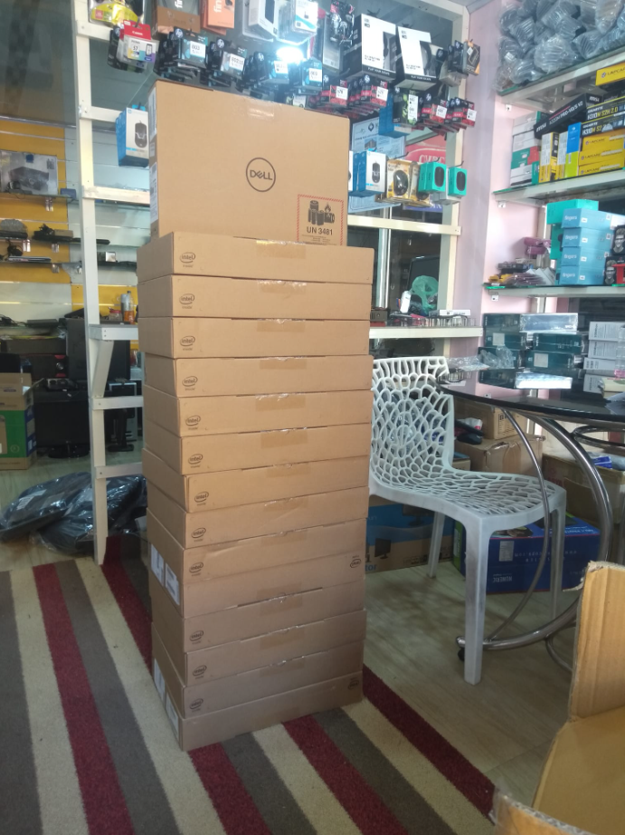
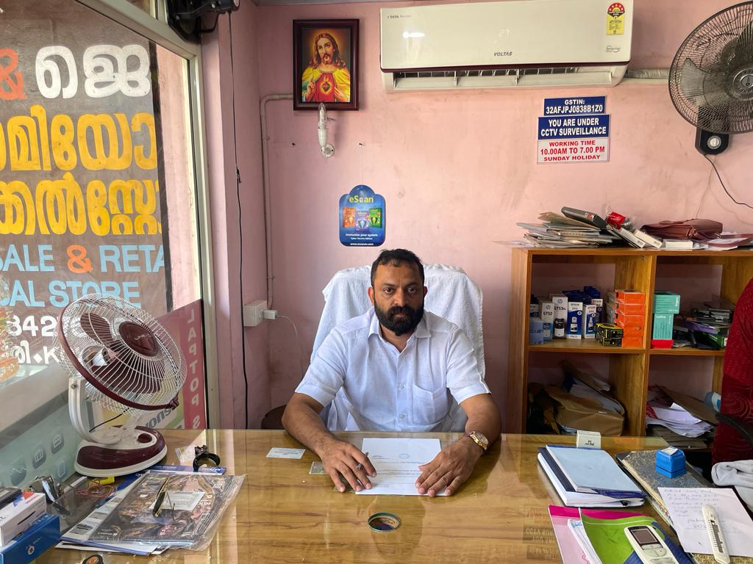
About the Project
Objective : Addressing challenges faced by Computech Computers – B2C Computer Store
Location : Kolenchery (Manjamkuzhi shopping complex, college junction), Ernakulam, Kerala
First computer store in Kolenchery
Organizational Details :
Founder : Mr. Sony P George (2007)
Sale and repair : computers, laptops, printers, modems, headsets, solar panels and CCTV cameras
Services : CCTV Installation, same day delivery, shop in-store
1

Slide 3
Problem Statement
01
03
02
Customer churn has significantly impacted sales & revenue
Increased competition due
to increase in influx of
e-commerce has led to decline in business
Lack of visibility among public & inferior quality products led to loss in revenue & customer loyalty
2

Slide 4
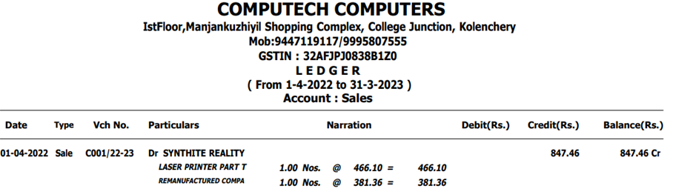
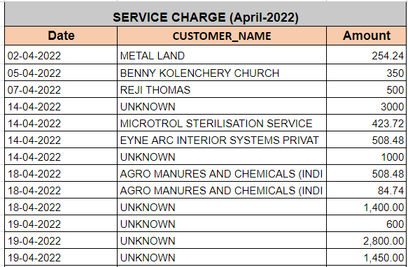
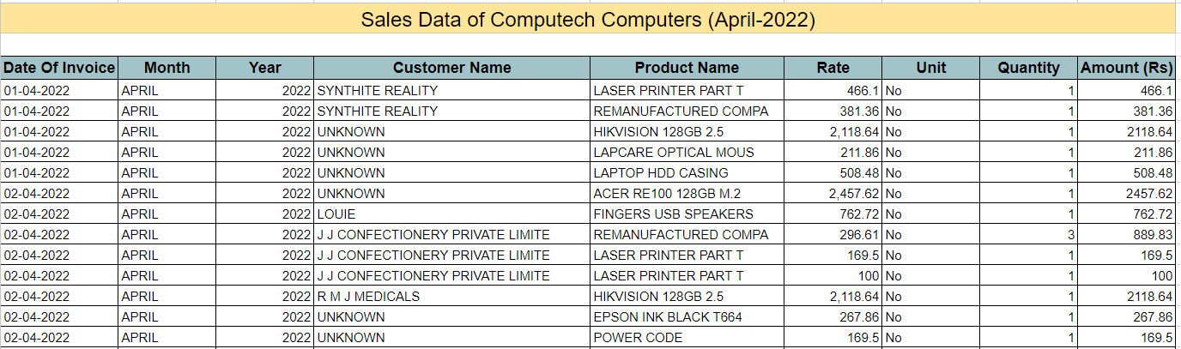
Data Collection & Preprocessing
Collection & analysis of sales & service data over FY 22-23
(April 2022–March 2023)
Data in ledger format
Preprocessed sales & service data in excel
3

Slide 5
Approach
Data Collection
& Preprocessing
Handling missing / incorrect values
Filtering unwanted outliers / duplicates / irrelevant data
Fixing structural errors
Exploratory Data
Analysis (EDA)
Descriptive statistics
Data visualization
Analysis of Sales data
& Service data
Revenue growth analysis
Month-wise volume analysis
Product growth analysis
Revenue contribution analysis
Customer contribution analysis
Trend analysis
Recommendation
4

Slide 6
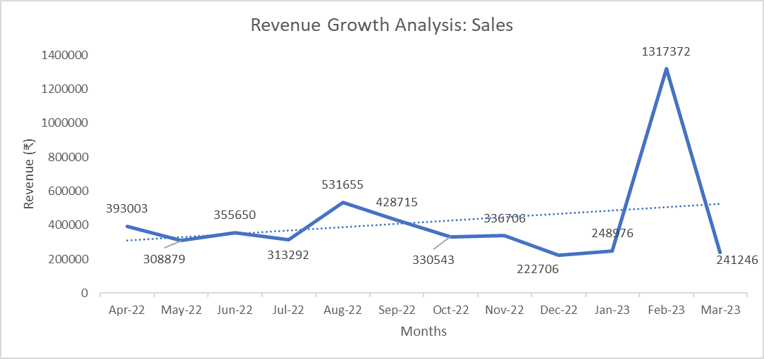
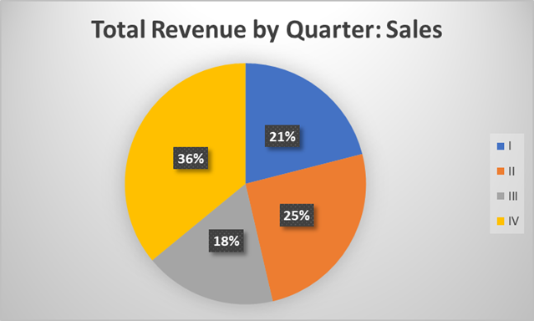
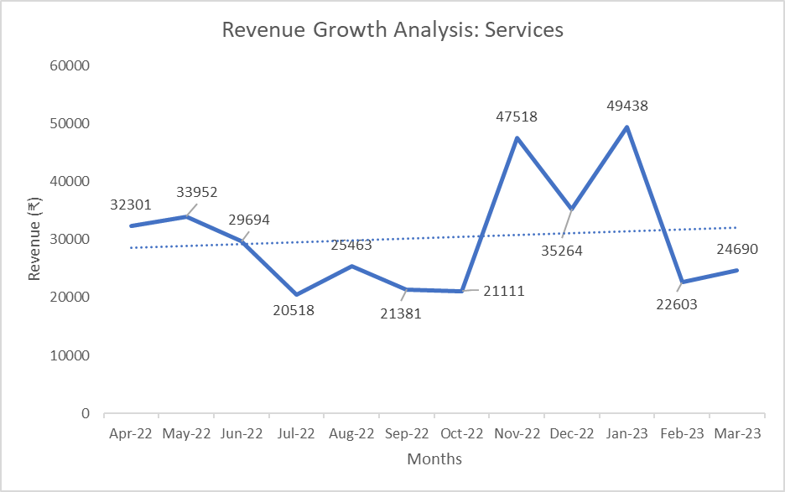
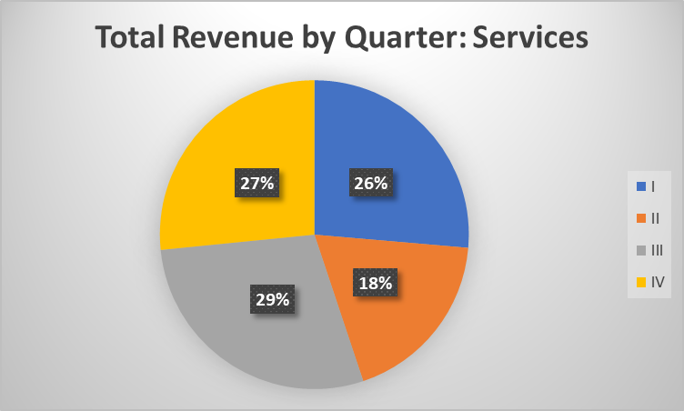
Revenue Growth Analysis :
Insight into the overall health of sales
Results & Findings
Highest revenue growth : Q4 (36%)
Lowest revenue growth : Q3 (18%)
Highest revenue growth : Q3 (29%)
Lowest revenue growth : Q2 (18%)
Growth stalls must be given immediate attention & should be reversed by new innovative product launches & effective marketing strategies
5

Slide 7
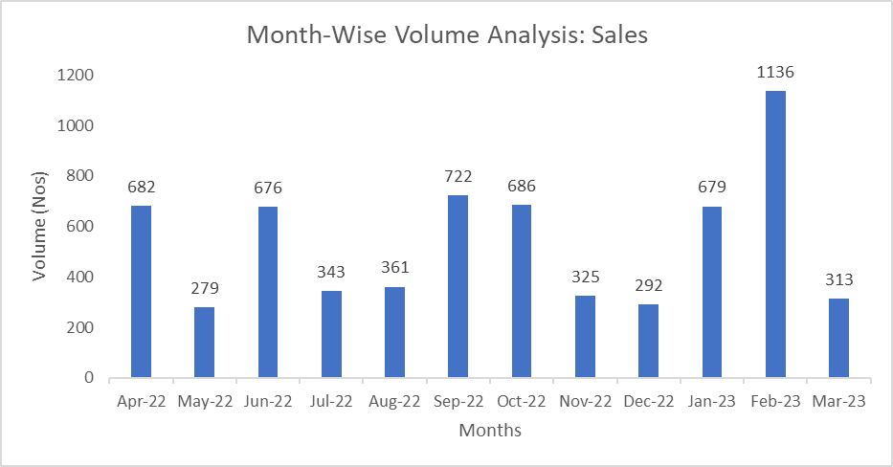
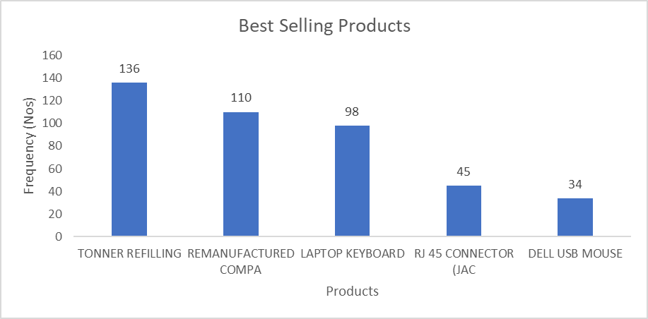
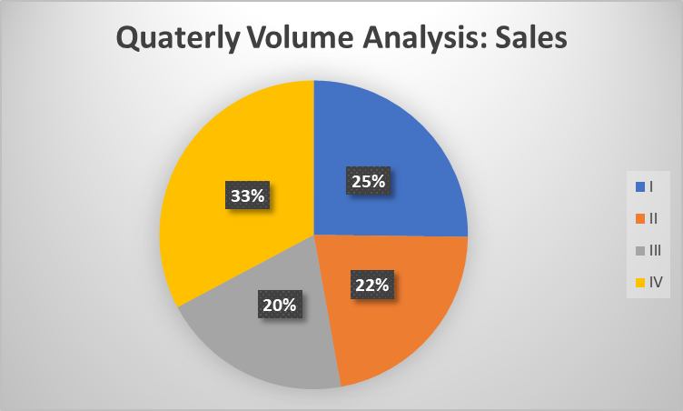
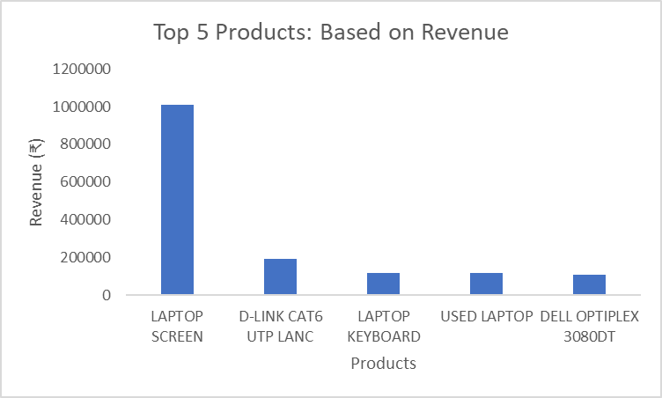
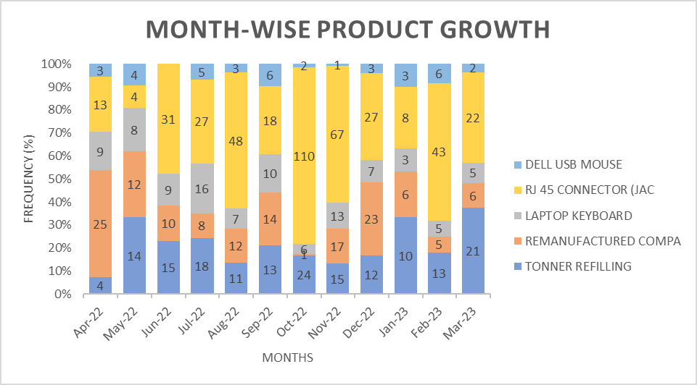
Month-wise volume analysis
Results & Findings (Contd)
Unsteady trend in trade volume
Growth highlights the need for more high quality products & better inventory management
Product growth analysis
Individual product contribution over each month
6

Slide 8
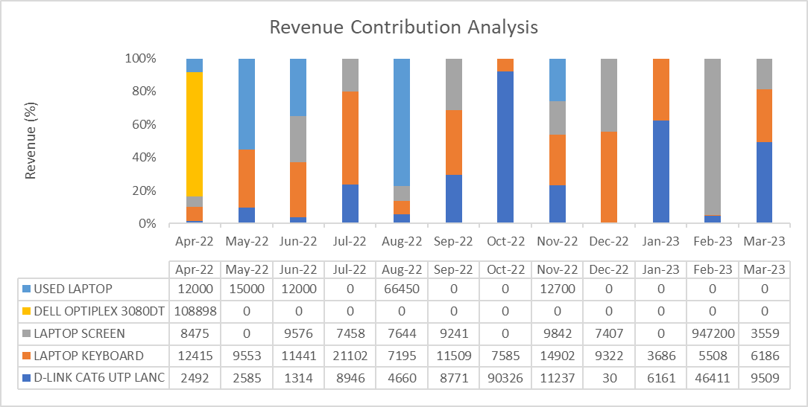
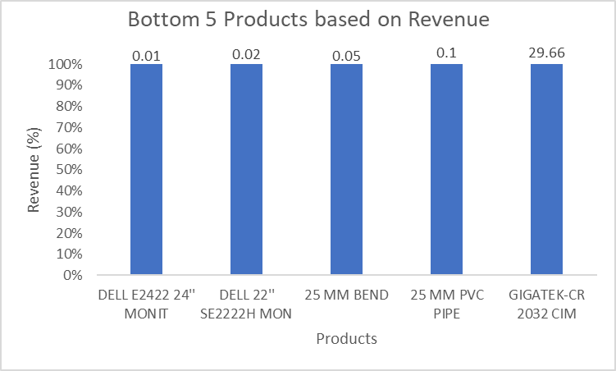
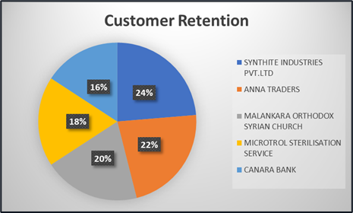
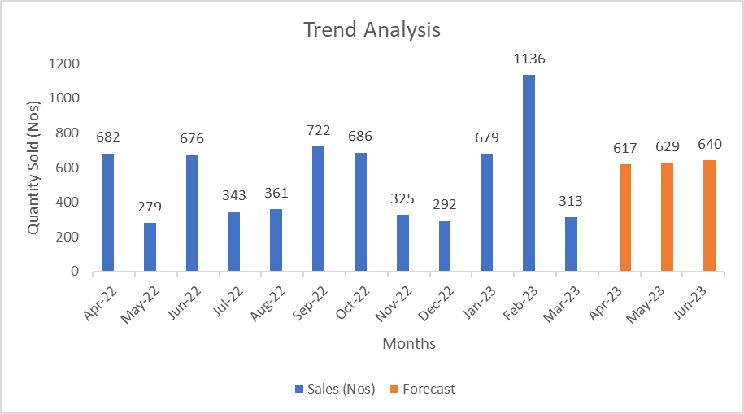
Revenue contribution analysis
Results & Findings (Contd)
Customer retention is observed in organizations such as :
Synthite Industries PVT.LTD (24%)
Anna Traders (22%)
Malankara Orthodox Syrian Church (20%)
Microtrol Sterilization service (18%)
Canara Bank (16%)
Total revenue contribution of Top 5 & Bottom 5 Products
Customer contribution analysis
Trend analysis
Stagnating growth in Q1
Inconsistency, reduced sales growth & uncertainity
7

Slide 9
Recommendations
1
Leveraging Influencer Marketing for business growth
2
Launching new products and improved inventory management
Unlocking global trade through Ecommerce
3
4
Collaboration with subsidiaries of Synthite Industries PVT.LTD such as Spice villa, Riviera retreat and vanilla grove
5
Embedding a customer feedback loop into product delivery
6
Purchase from local vendors instead of overseas export
8

Slide 10
THANK
YOU!
9

